Slide 1

GAV 2b
Language groups
1st – 20th de August, 2020

Slide 2

Organizational logistics
Each language group will decide when to meet, how many times and which platform to use.
If you wish to use the Zoom platform contracted by FIMEM, request it and present the dates of your meetings. It is necessary to plan the meetings since it is not possible to have two meetings with this same platform simultaneously.
Where and from whom do I request the Zoom platform?
To Gabi, to the commission's email: agvirtual2020@gmail.com
The advantage of this platform is that it accommodates up to 300 people and video calls are not cut off every 40 minutes, as in the free version.

Slide 3
The AG2b or "Language Groups" (or languages) is the space, together with the meetings of the movements, where the voices of all the participants of each movement are present: where discussions are held, proposals are made, collective positions are taken, the first agreements are reached.
Language Groups
Participation: a key moment of the General Assembly

Slide 4
To be considered:
The language groups present their conclusions, proposals and discussions through the report to the Virtual GA Commission and the CA, in order to establish the priorities for the GA3:
which are the urgent proposals to be solved, which are the ones that can be treated later, which are by email, which are by commissions, or which will require to be dealt with in the presence; the non-presence makes everything more complex (in all areas of life).
Technology brings us closer, it helps us, however, it does not replace the presence (we have proven this with our classes in our schools) and therefore, we will have to have the strength and awareness that there are issues that will be more appropriate to treat them in person.

Slide 5
Reports by language group
The reports (minutes, reports) must be submitted on August 21st or 22nd as the deadline, since it is necessary for the AGV Commission and the CA, as mentioned above, to establish the priorities for the GA3, as well as those proposals that may have a subsequent treatment, via email, by commissions or that will require attendance.
Deadline: August 21st and 22nd.
Send to: agvirtual2020@gmail.com and to: cafimem@gmail.com
Reports must be delivered in the three official languages of FIMEM:
English, Spanish and French
(you can use translators such as DeepL, for example, which works quite well).

Slide 6
Representatives of the language groups
Each language group will need to elect a representative with whom the Commission and the CA will have direct contact through emails, in order to deliver information, comment on doubts, send the report-report, among other needs.
Send name/email/country/movement of the group representative to: agvirtual2020@gmail.com with copy to: cafimem@gmail.com

Slide 7
Division of language groups
The language groups will be:
- French (can be organised with more than one group)
- English
-Spanish
It is possible to subdivide if necessary, for example, into a German language group or an Italian language group, this in case they decide or are organised

Slide 8
Contact with the Language
Groups :
The Commission will provide three e-mail lists with the contacts per language group (the delegates of each movement per language group); integrating Italian to the Spanish language group, as well as Portuguese. There will then be 3 e-mail lists:
Spanish
French
English
It has been considered that the German language group does not need a list since they are already organised.

Slide 9
Lists of language groups
Ready for language groups.
Delegates are responsible for contacting each other and setting the dates and times of language group meetings. The AAG committee creates these lists so that they can be easily contacted.
grupo-de-lengua_es@framalistes.org
groupe-de-langue_fr@framalistes.org
language-group_en@framalistes.org
Each list, with the name and country of each delegate, will be detailed by e-mail.

Slide 10
Agenda
The agenda was discussed during the 4 briefings with the delegates. It is necessary that the delegates, then, be the spokespersons of those meetings. In order to follow a guideline, the following documents can be taken into account:- Agenda "Ordre du jour AG Virtuelle" https://www.fimem-freinet.org/es/node/3762
on the tab of the site called: "Ordre du jour + PV"- Items to be validated at the GA "points a valider" which can be found on the website, on the tab of the site called: "courriers AG" https://www.fimem-freinet.org/es/node/3822
All the documents mentioned there are on the site. Each language group will add the topics it considers appropriate for discussion, and will take the motions of the other movements also published on the site at this link: https://www.fimem-freinet.org/es/motions2020

Slide 11
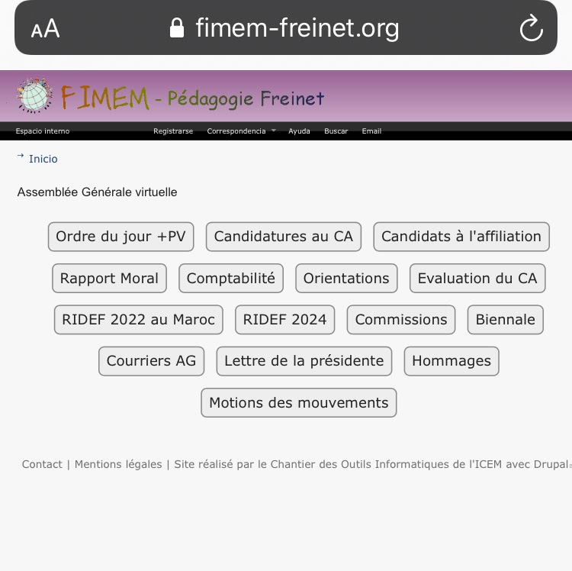
List of documents of the web site of the FIMEM and search guide

Slide 12
Site guide and links:
Tab "Ordre du jour + PV" (Agenda): https://www.fimem-freinet.org/es/odj-2020
- Minutes of the GA1 of 4 and 5 July, as well as that of 11 and 12 July - -Agenda of the Virtual General AssemblyButton "Canidatures au CA"
Applications to the CA: https://www.fimem-freinet.org/en/candidatures-CA-2020
- APPEL à candidature au CA (Convocation and skills)
- Glaucia (Brazil)
- Marguerite (France)
- Mohamed (Morocco)
- Antoinette (Cameroon)
- Cheikh (Senegal)
Tab "Candidats à l'affiliation": https://www.fimem-freinet.org/es/candidatures-CA-2020
- Demande (instructive)
- Congo
– Ghana

Slide 13
Site guide and links Moral Report
Report tab: https://www.fimem-freinet.org/es/rapport-moral-2020
- Moral Report / - Activities CA 2018-2020
Comptabilité tab: https://www.fimem-freinet.org/es/compta-2020
- Bilan comptable 2018-2019 (Financial accounting balance sheet).
- Budget 2020-2021- (Budget).
- Commentaires de la trésoriere (Treasurer's comments).
- Proposition pour nouvelle categorisation. (Proposal for new contribution under HDI with inequality).
- Cotisations- IDHI- July 2020
- New movement categorizations FIMEM
- Inequity adjusted to IDH
"Orientations" tab: https://www.fimem-freinet.org/es/orientations-2020Orientations
Bilan. Orientations Bilan et prospectives (Balance Sheet Guidelines, 2018-2020). (Guidelines: prospective, 2020-2022).

Slide 14
Site guide and links
Basic tab "Evaluation du CA" (Evaluation of the CA)
- VacuumBasic tab "RIDEF 2022 au Maroc" (RIDEF of Morocco, 2022)
- VacuumBasic tab "RIDEF 2024" (RIDEF of 2024)
- Vacuum
Basic tab "Commissions": https://www.fimem-freinet.org/en/commissions2020
- Commission No 4 (Commission 4)
- Report of the FIMEM Virtual General Assembly / (Informe de la Asamblea General Virtual de FIMEM)
- Proposal for new categorisation
- PV commission AGV of 9 July (9 de julio informe de la Comisión AGV)
- Rapport commission AGV
- Commission 6 : gestion des Ridef
"Biennale" tab: https://www.fimem-freinet.org/en/biennale
-AG-2020 - 2019. Biennial Report by Francois Perdrial. (Biennial Report by Francois Perdrial)

Slide 15
Site guide and links
Courriers AG tab (General Assembly messages): https://www.fimem-freinet.org/es/courriersAG-2020
- News from Quebec.
-Virtual AG for more information. (Virtual AG for more information)
- News. How the GA works
- July 3. (News. GA operation - July 3)
- Points to validate ... to discuss ...
- Virtual AG Canada's position as of July 2. (Virtual GA Canada's position as of July 2.)
- Invitation to the July 11th session.
- Questions from the ICEM to the CA FIMEM for AG - FR-ES-EN. (Questions from the ICEM to the - Board of FIMEM for AG - FR-ES-EN)
- Information on the Benaiges Stock Exchange.
- Board Responses to ICEM Questions.
Tab "Letter from the President": https://www.fimem-freinet.org/es/lettre-presidente-ag2020
Links "Hommaneges": https://www.fimem-freinet.org/es/hommages2020

Slide 16
Site guide and links
Tab "Motions des mouvements": https://www.fimem-freinet.org/es/motions2020
- Position des mexicains sur la pandémie.
-Motion: communication au sein de la FIMEM proposée au vote par l'ICEM à l'AG de la FIMEM 2020. (Motion: communication within FIMEM proposed to vote for ICEM at FIMEM 2020 General Meeting)
- FR-Motion: actions à mener face aux politiques migratoires proposée au vote par l'ICEM à l'AG de la FIMEM 2020. (Motion: actions to be taken on migration policies proposed to the vote by ICEM at the FIMEM 2020 General Assembly)
- REMFA Position
- Reflexion pour la Ridef du Canada de Giancarlo. (Reflection for RIDEF du Canada by Giancarlo)
- MEPA Position on the Pandemic. (MEPA Position on the Pandemic)

Slide 17
Doubts/ comments/ questions/ suggestions:
GA Virtual organization: agvirtual2020@gmail.com
Themes and general questions: cafimem@gmail.com

Slide 18
"Everything is ready: the water, the sun and the mud, but if you are missing... there will be no miracle".
Mario Benedetti (Uruguay, 1920- 2008)
Translations by Marta Fontana, Marguerite Gomez
Texts by GAV commission- FIMEM.

